Slide 1
Implement of a New Runge-Kutta Method for the System with Uncertain Discontinuous Change
Jiechao Wang, Peiqing Han
December 25, 2015
Notes:
Hello
Topic is…
We are pleasured to share our work with all of you

Slide 2
Outline
Introduction
Problem Formulation
Solution Method
Numerical Results
Conclusion
Notes:
Firstly, in this presentation we will cover 5 parts
Introduction of our work and the problem we want to solve,
We will give the model and formula of it
Then we will forces on our method to solve this problem.
Finally we will analyse results of our method
At last, the conclusion

Slide 3
Introduction
We want to simulate some simple systems whose state change discontinuously.
The system follows an Ordinary Differential Equation.
Notes:
In the topic we are considering the system that the components change suddenly
And the system could be the form of ODE
In some paper about the Robotics they proposed this systems, when simulating the jump robots or something similar

Slide 4
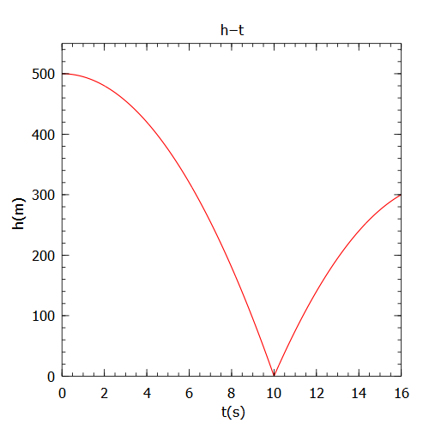
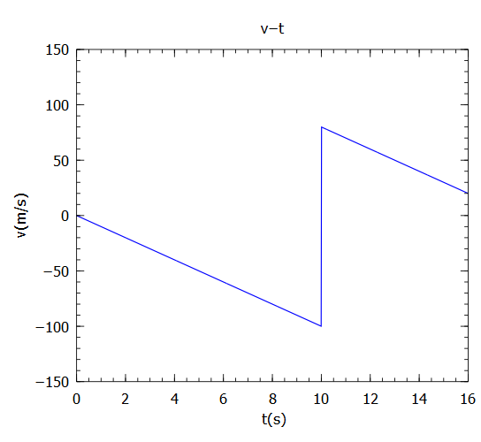
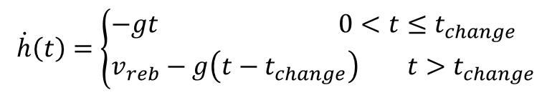
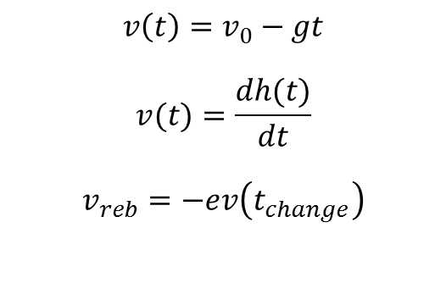
Problem Formulation
Considering the system of rebounding of a ball as an example. The model is shown in Figure 1 and Figure 2.
$$\dot{h}\left(t\right)=\left\{\begin{aligned}&−gt 0<t≤t_{change} \\ &v_{reb}−g\left(t−t_{change}\right) t>t_{change}\end{aligned}\right.$$
$$v\left(t\right)=v_{0}−gt$$
$$v(t)=\frac{dh(t)}{dt}$$
$$v_{reb}=−ev\left(t_{change}\right)$$
Figure 1: Position of the ball Figure 2: Speed change with rebounding
Notes:
Let’s look at 1 familiar situation, a ball falls from a higher position
The speed v(t) of the ball is a differentiation of the position h(t)
Then the ball hit the ground and rebounded by the ground, so the speed of the ball reversed suddenly.
The position h(t) line is shown in Figure 1 and Figure 2 shows the speed of it.
There is a change of speed when t=10s
Considering the change, we could get the differential equitation of this system.

Slide 5
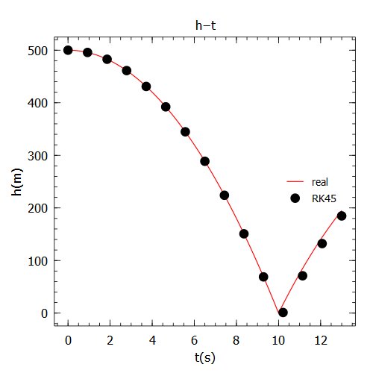
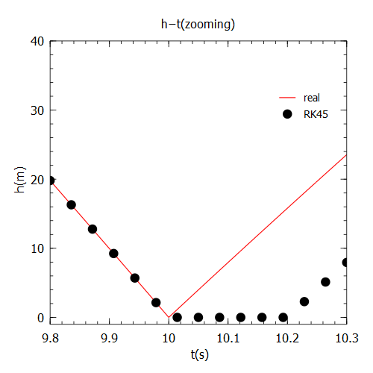
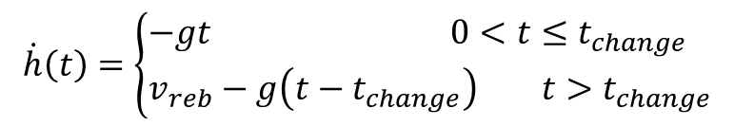
Problem Formulation
If we regard it as an general ODE, the result of RK45 (Dormand-Prince) with step-size control is in Figure 3,4
$$\dot{h}\left(t\right)=\left\{\begin{aligned}&−gt 0<t≤t_{change} \\ &v_{reb}−g\left(t−t_{change}\right) t>t_{change}\end{aligned}\right.$$
Figure 3: RK45 method’s result Figure 4: Offset after the change point
Notes:
When we look at this equitation we will think about the traditional Runge-Kutta method to solve this problem.
But there is a change point, and we could prove the equitation is not Liptchize continuous, so the RK45 method with step-size control can’t work well.
And when we use RK45, we get the result it figure 3 4
Firstly maybe we would think it works well, but when we zoom in the points around change point
We could see there is a big error.
The reason is that when Runge-Kutta go to the change point, the step size will become smaller and smaller
When the step size scaled to EPS, it will pass the change point and the step size couldn’t become bigger.
It will calculate too many steps after change point.
So we get the error and the method coast really too much time.

Slide 6
Solution Method
Determine the change time
Runge-Kutta method for the uncertain discontinuous change
After passing, restart RK45
Figure 5: Step size control around the change point
Figure 6: New Runge-Kutta method
Notes:
Our flow chat is shown in Figure 5.Firstly,we use RK45 with step-size control to calculate x(ti+h) until it meets condition that the change has occurred .Then we make half of h and go back to the first calculation if h is bigger than threshold. Secondly , when h satisfies the condition ,it will use the fixed time step hc only once .We proposed a modify Euler's method + 4th order Runge-Kutta method . As shown in Figure 6,this method assumes that the change happens in the middle of hc/4 .In the stage ,we calculate it by the modify Euler’s method . After that , we use 4th order RK to arrive the next time . Finally, We will restart RK45 after passing it.

Slide 7
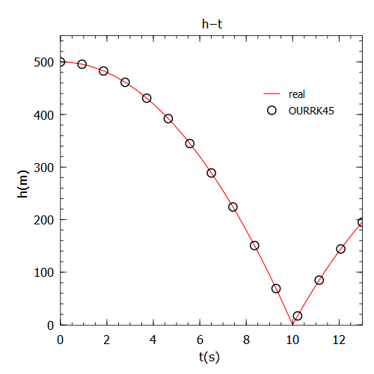
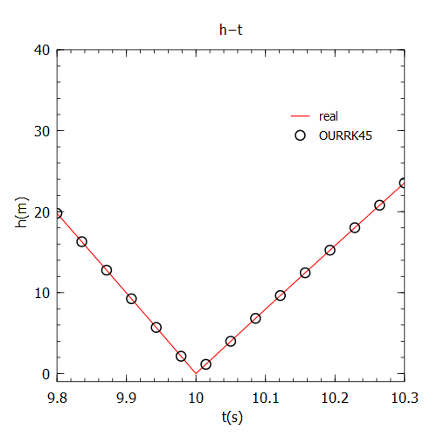
Numerical Results
Assume the ball falls from h0=500m.
New Runge-Kutta method results in Figure 7 and Figure 8.
Figure 7: Position of the ball Figure 8: Speed change with rebounding
Notes:
We consider the simulation of a rebounding ball in the initial h which equals 500 mile .We can clearly see the two pictures above . With Our method , we solve the system which uncertain discontinuous change . It fits real orbit regardless in continuous or in discontinuous.

Slide 8
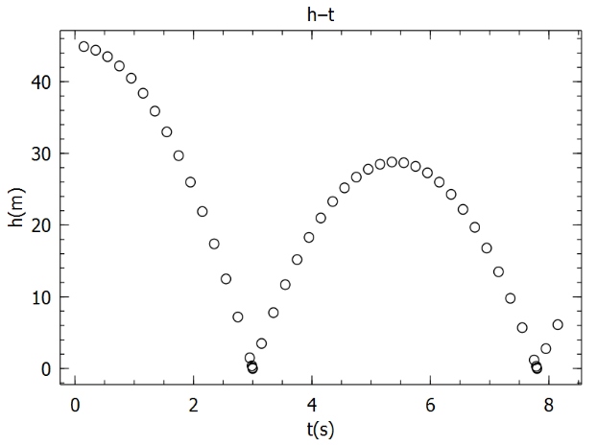
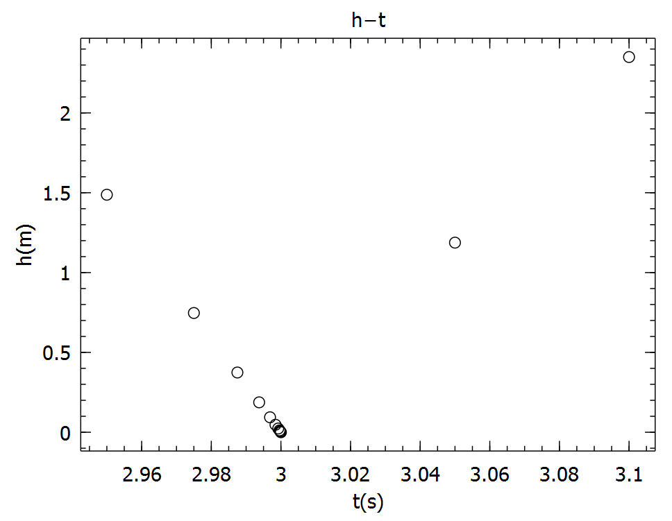
Numerical Results
Step size scaled around change point.
Figure 9: Position of the ball Figure 10: Speed change with rebounding
Notes:
Finally Let’s look at the step size around the change time.
We could see that it’s scaling down to simulate the change point.
And after the change point, the step size gets bigger and it is the same as RK45 and detecting the next change.

Slide 9
Conclusion
Discontinuous change
Defect of RK45 method
Improve RK45
Implement
Fit change point accurately

Slide 10
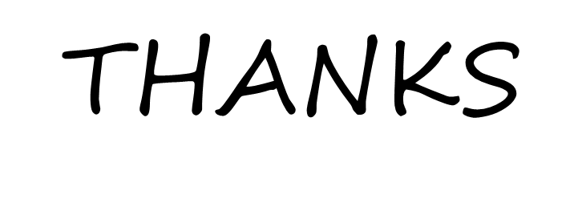
Questions & Answers
Jiechao Wang Peiqing Han

